Slide 1



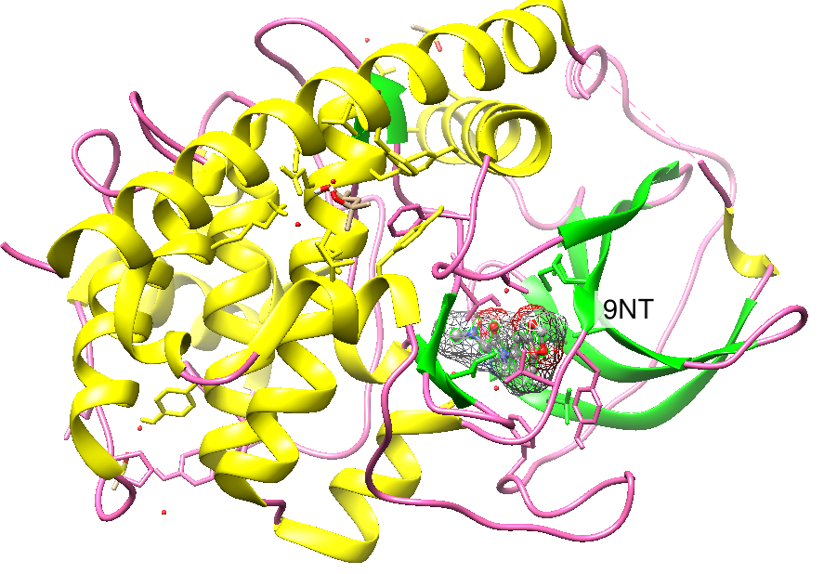
International Centre for Quantum and Molecular Structures
VIBrational Effects and Spectroscopy
Spectroscopic Advantages of Q|R:
Chromophores inside Protein
Reporter: Zhang Hongli (张宏丽)
Supervisor: Malgorzata Biczysko
Date: 12 April 2019
PDB ID: 5N1E
Notes:
I am going to foces on

Slide 2
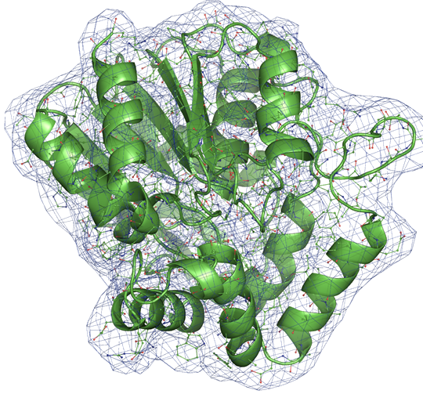
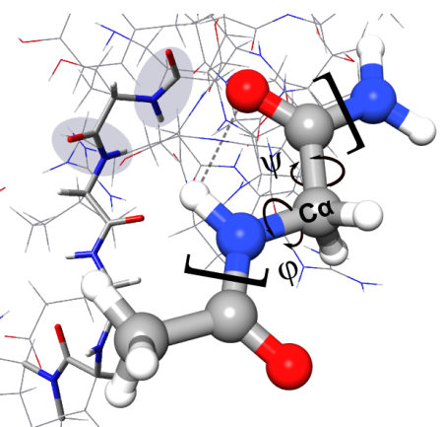
QM for refinement of protein crystal structure
PDB: from experiment to structure
Unusual cases : QM support
QM data to support standard refinement
Standard vs QM refinement
Purpose: highlight some spectroscopic advantages of Q|R on chromophores inside protein.
Methods: Use Gaussian16 (or sTDA and so all) to simulate the UV-Vis of chromophores inside proteins.
Notes:
通常我们从数据库获取蛋白质的详细信息，但这些数据都是通过实验taken from获得的，例如X射线，NMR.
但是所有的系统都是柔性的，有着不同的结构，使解释光谱成为挑战，我们将量子力学的方法引入支持标准的精修，第一性原理计算成为分析光谱的重要工具。
first principle computations have now becoming an important tool to support spectroscopists in the analysis of experimental data

Slide 3
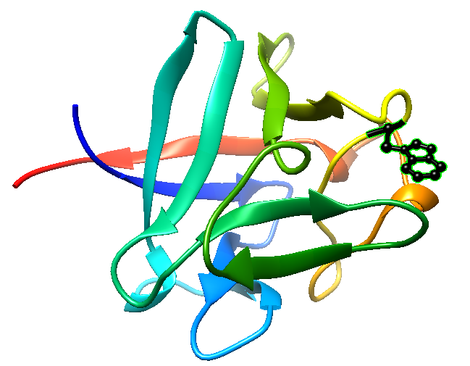
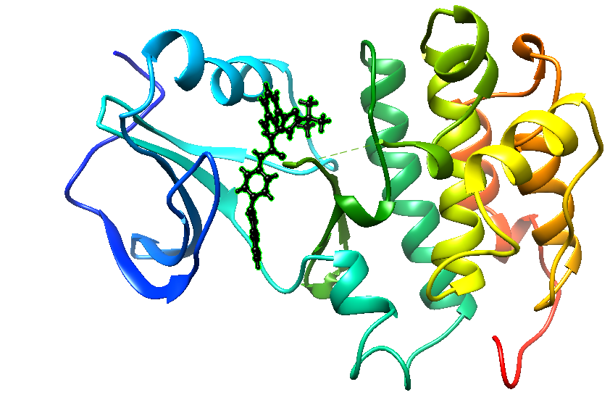
Choose System
A. Chromophore embedded in protein (no covalent bonding with protein)
B. Chromophore as part of protein.
（amino acid: PHE TRP TYR）
eg: 3tz9
eg: 1bff
TRP
Ligand AQU

Slide 4
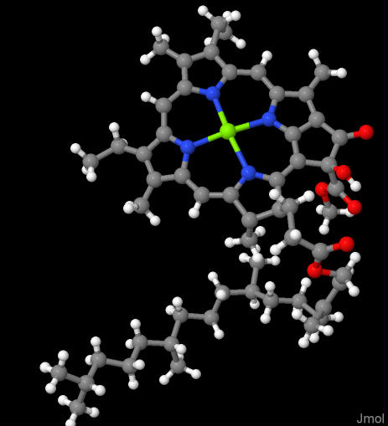
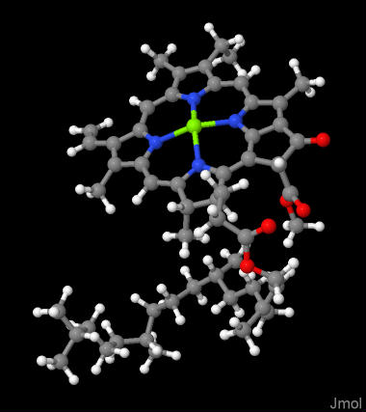
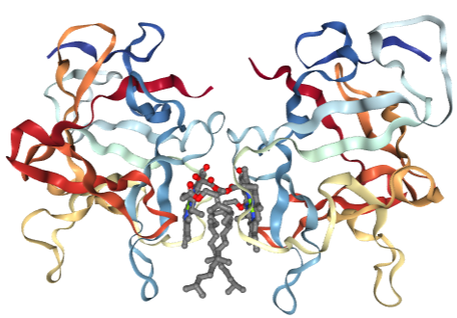
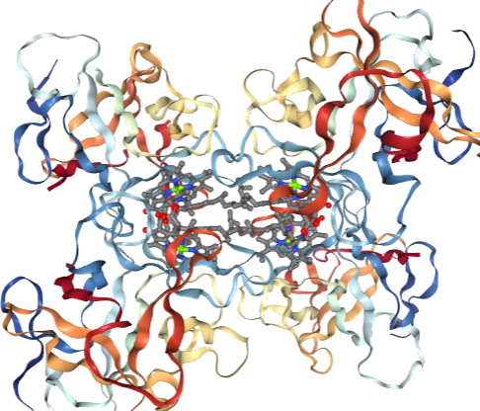
WSCPs (water-soluble chlorophyll binding proteins )
68G
CLA
5HPZ(Qy band at 673 nm)
2DRE(Qy band at 664 nm)
WSCPs shows some spectra shifts due to the deformation of Chl macrocycle planarity .
Notes:
Newly studied /refined system is 5HPZ, it’s chromophores 68G have an OH group instead of H atom compared with the 2DRE chlorophyll (CLA), that was due to the observed electron density.

Slide 5
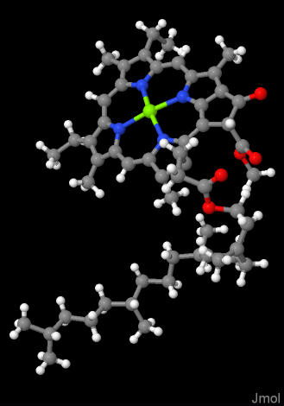
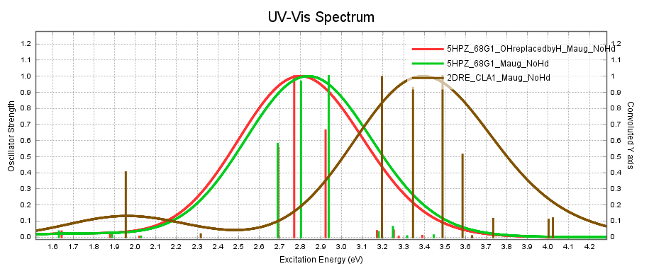
2DRE_CLA
5HPZ_68G
5HPZ_68G OH replaced by H

Slide 6
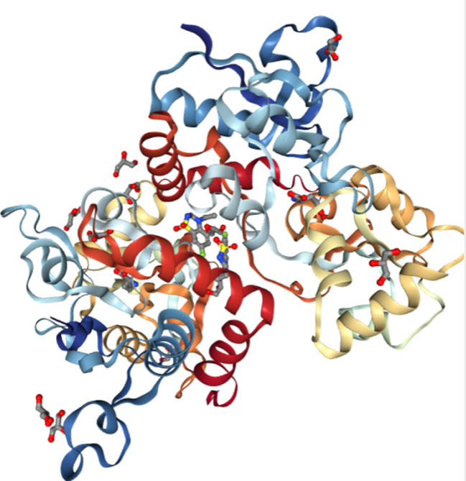
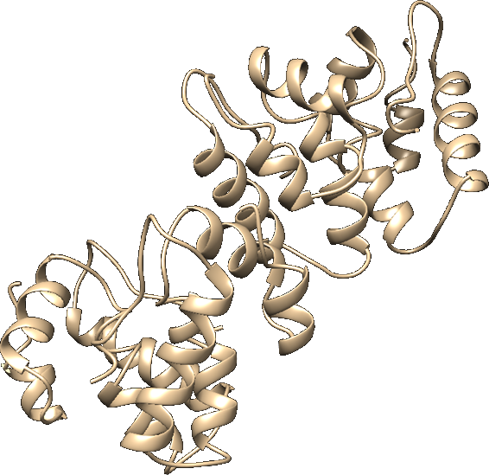
Quantum Refinement = better non-covalent interactions, unusual regions, ligands etc.
Spectroscopy (UV-vis, ECD, IR..)
Geometric effects on “active site”
Steric and electrostatic effects of “environment”
+
=
ΣSpecific Effects=Overall Spectrum
Notes:
传统方法只关注原子间的相互作用，分子与环境之间的相互作用却很微弱，量子精修擅长关注非共价作用力，将空间的配体分子与整个环境联系起来，发现他们的立体效应与电子效应，通过势能面的转化发现活性位点的几何效应，实验数据与量子精修相结合，就可以理解各种效应对整个光谱的影响。

Slide 7
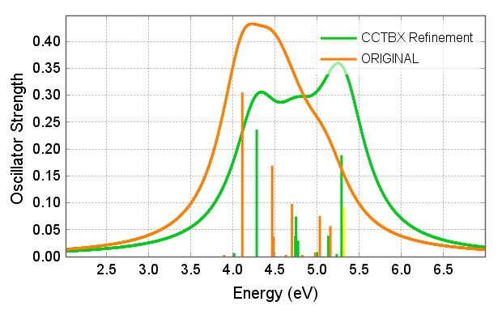
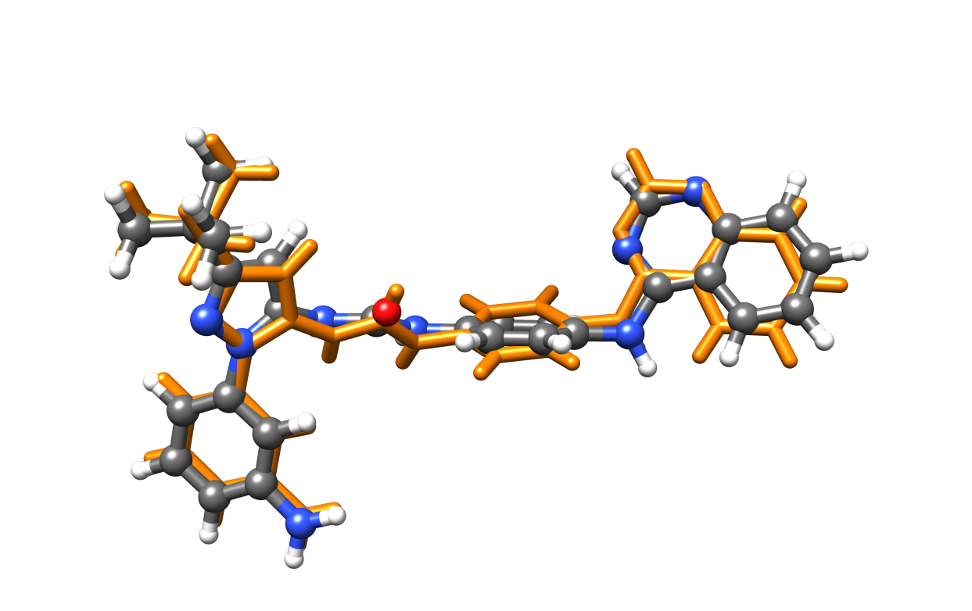
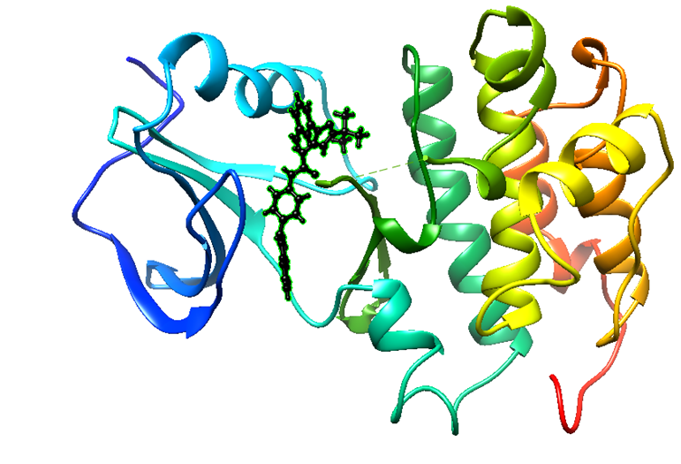
Simulated Spectroscopy (From PDB to Q|R : geometric effects)
3TZ9 Ligand AQU UV-Vis spectroscopy (TD-CAM-B3LYP/SNSD)
CCTBX Refinement compared with Original PDB.
Q|R work in progress.
Notes:
Highlight some spectroscopic advantages of Q|R on chromophores inside protein.
Computational Crystallography Toolbox

Slide 8
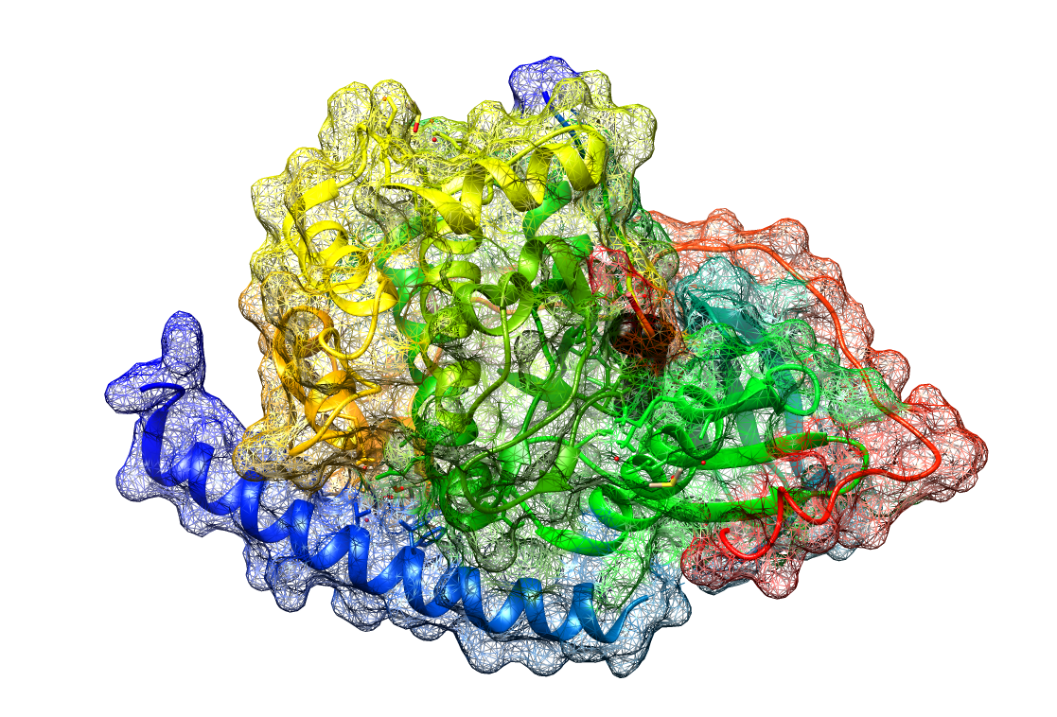
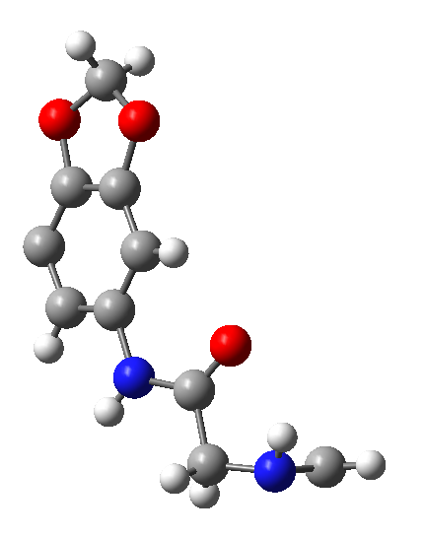
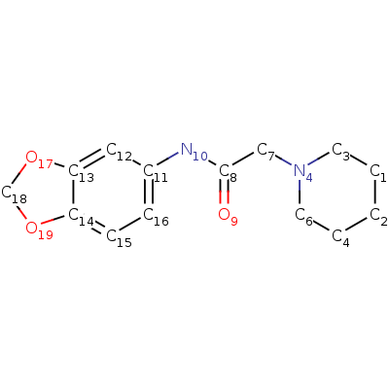
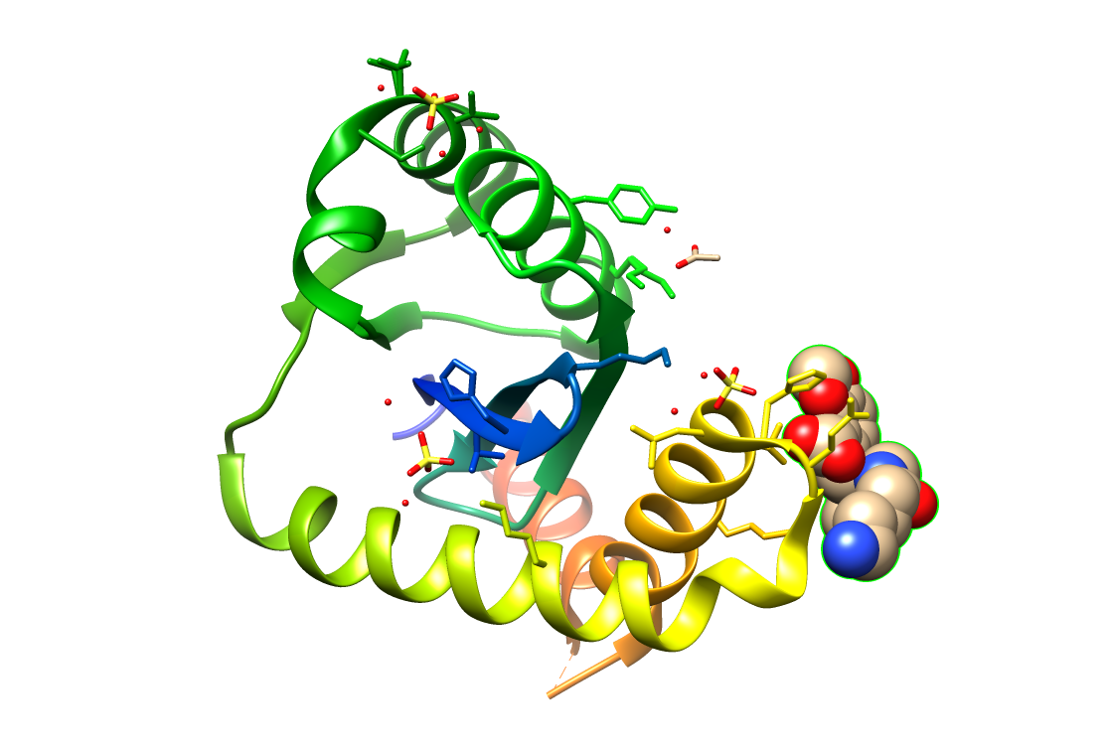
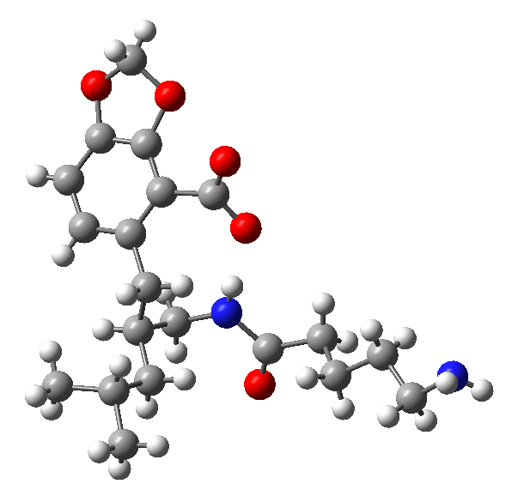
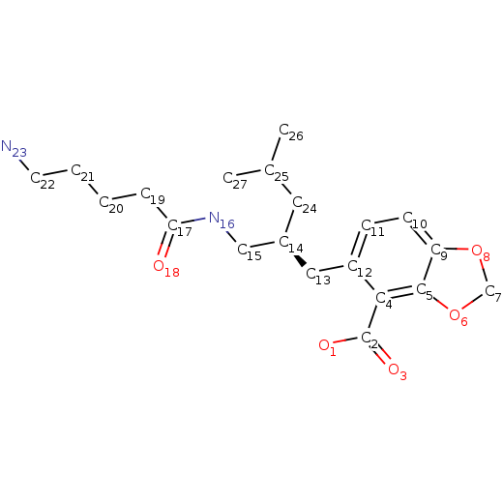
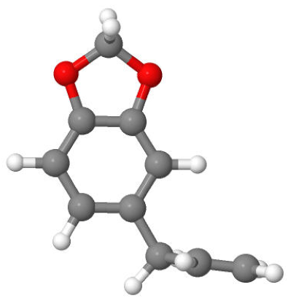
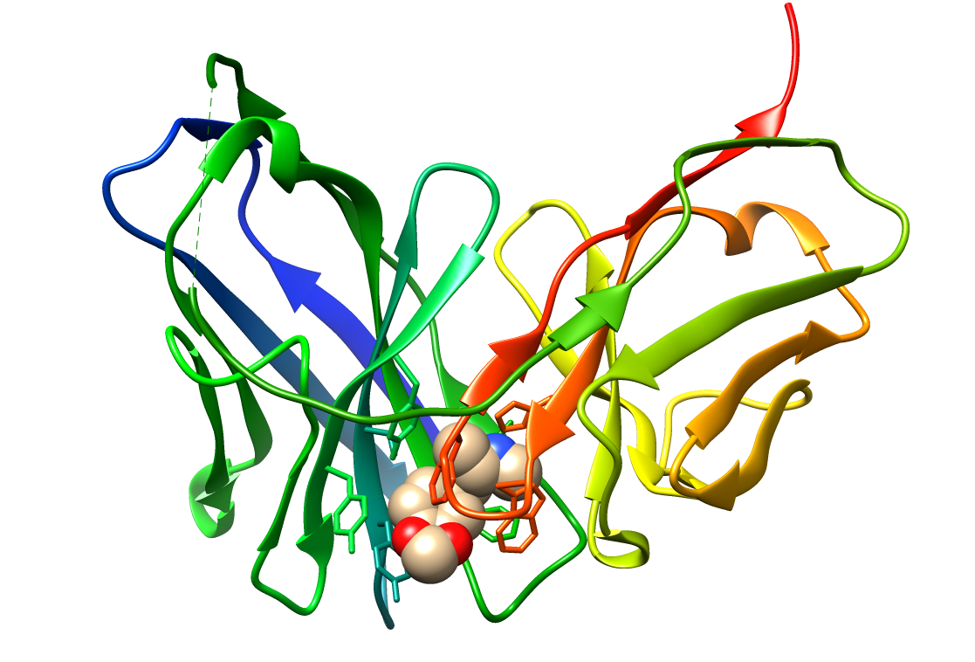
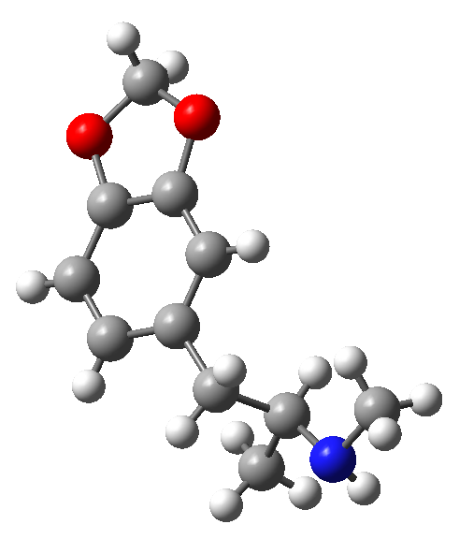
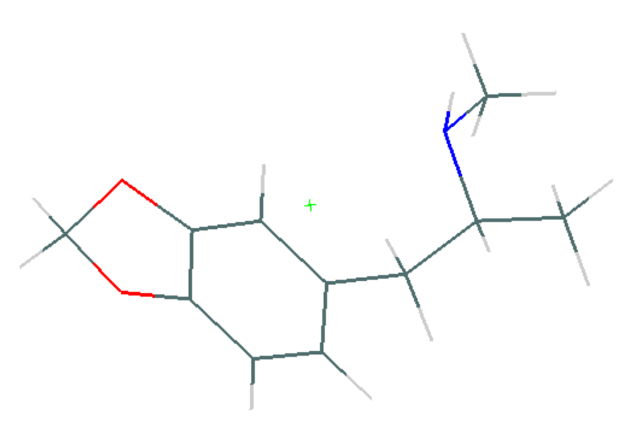
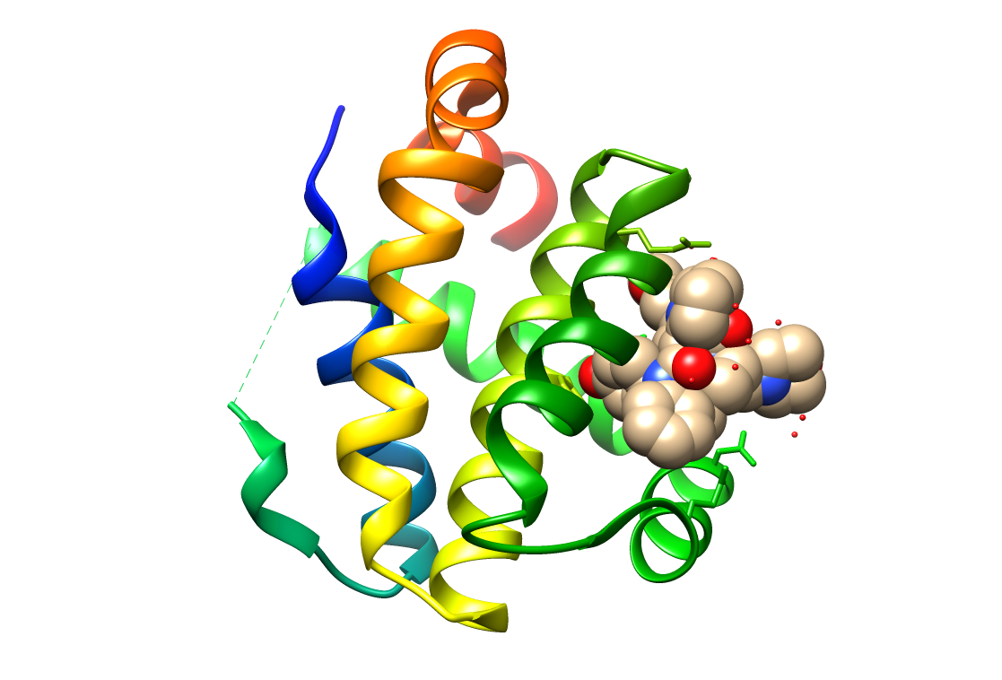
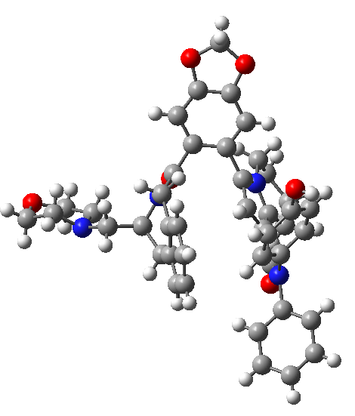
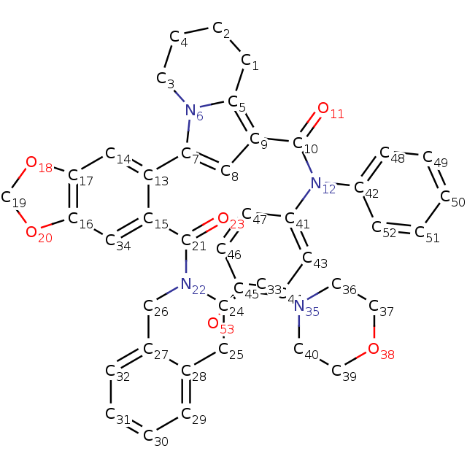
9NT
5n1e
9PA
4cjl
Safrole
B41
3gm0
F3Q
6gl8
Safrole based chromophores embed in proteins.
Notes:
黄樟素是一种丰富的天然产品，它的两个官能团导致构象灵活性，引起了有趣的化学功能，可用于制造杀虫剂，香料和其他化学品。
事实上，黄素被认为是一种弱致癌物质，但当与氨基酸残基或小肽结合时，具有抗肿瘤活性.
safrole is an abundant natural product，its functional groups lead to some conformational flexibility, which induces interesting chemical functionality。So used to manufacture pesticides, fragrances, and other chemicals. Actually, Safrole regarded as a weak carcinogen, but when conjugated with amino acid residues or small peptides it can display antitumor activity .

Slide 9
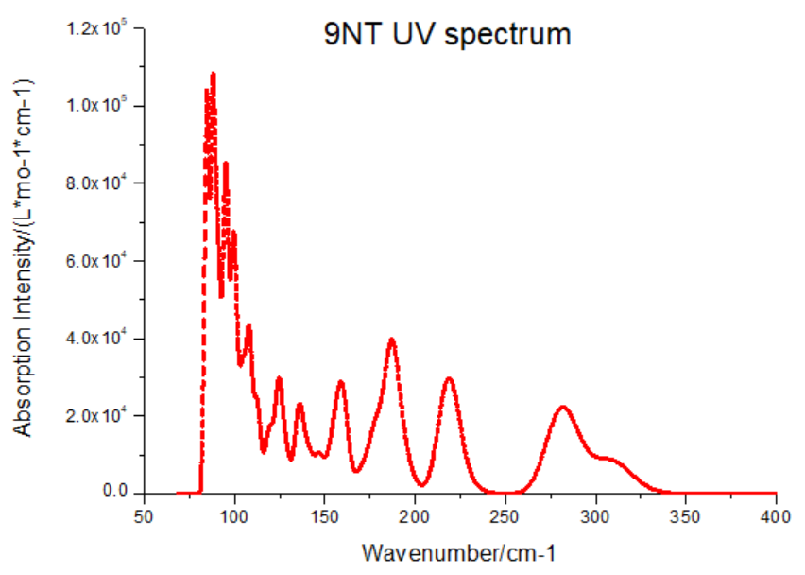
5n1e
9NT
cctbx
Gaussian
sTDA
g_spect
Stefan Grimme (and the development team)
5n1e-------9NT
4cjl -------9PA
3gm0------B41
6gl8 ------F3Q
opt/refine
Ground state
Excited states
Plot pectrum
Workflow for computation of electronic spectra of chromophores embedded in protein.

Slide 10
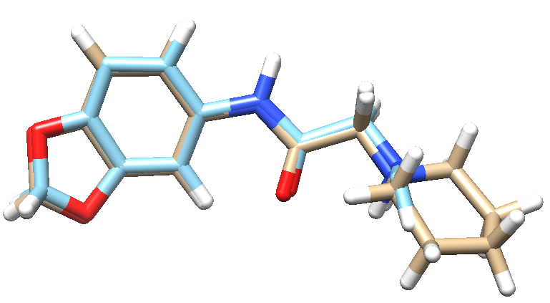
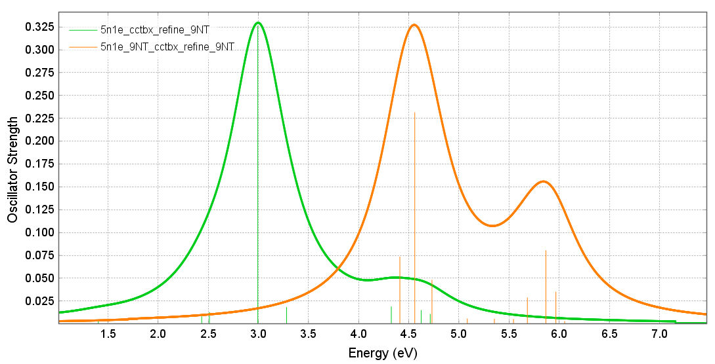
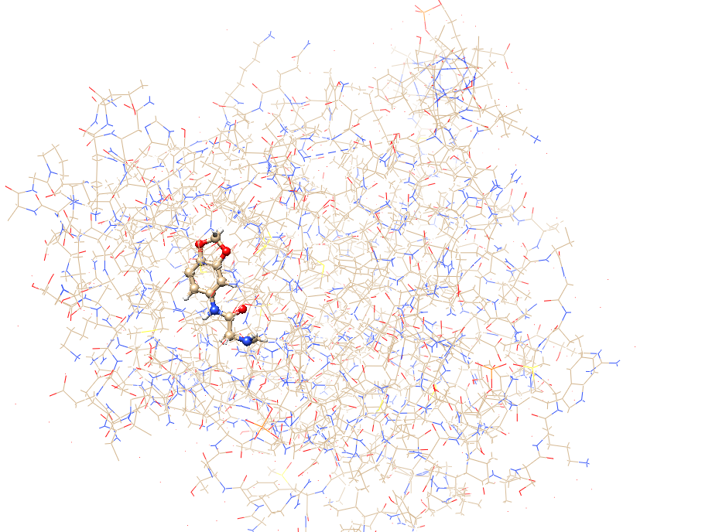
9NT UV-Vis spectroscopy
Comparison between spectra computed for correct (orange) and truncated (green) structures of 9NT ligand embedded in 5N1E protein.
5n1e_cctbx_refine_9NT: 5n1e do cctbx refinement and pick up 9NT（blue structure）
5n1e_9NT_cctbx_refine_9NT: use chemistry restrains 9NT replaced 9NT of 5n1e,
do cctbx refinement and pick up 9NT(brown structure)
TD10 CAM-B3LYP SNSD_CdOk.gbs

Slide 11
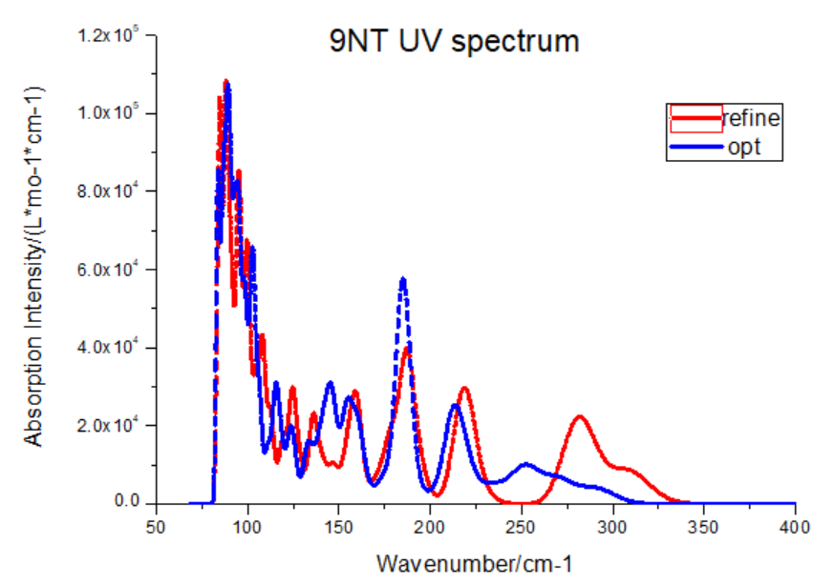
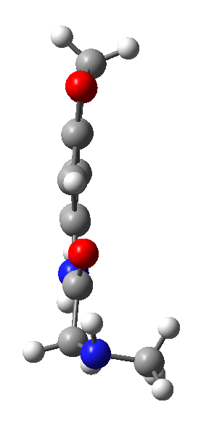
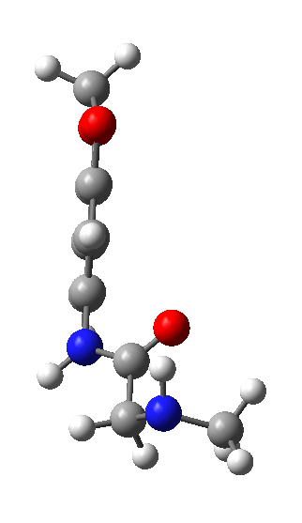
5n1e_cctbx_opt_9NT.pdb
5n1e_cctbx_refine_9NT.pdb

Slide 12
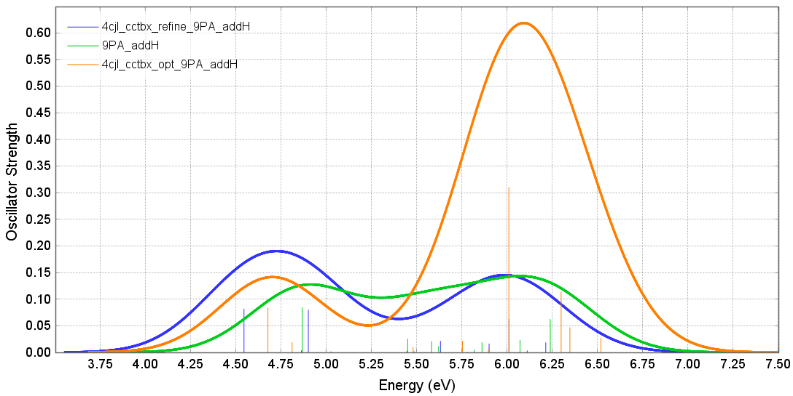
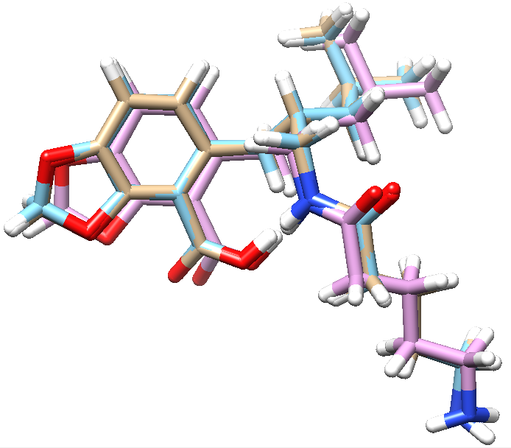
4cjl_cctbx_refine_9PA_addH: 4cjl do cctbx refinement and pick up 9PA add H.
4cjl_cctbx_opt_9PA_addH: 4cjl do cctbx optimization and pick up 9PA add H.
9PA_addH: chemistry restrains 9PA add H.
TD10 CAM-B3LYP SNSD_CdOk.gbs

Slide 13
Thank you for your attention!
International Centre for Quantum and Molecular Structures

